Slide 1
What we have learned so far..

Slide 2
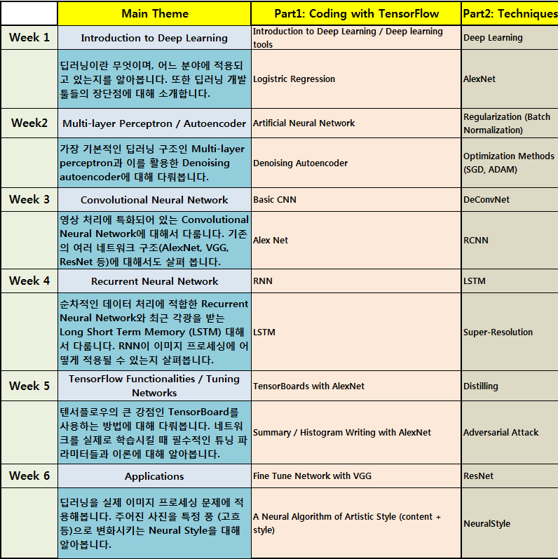

Slide 3
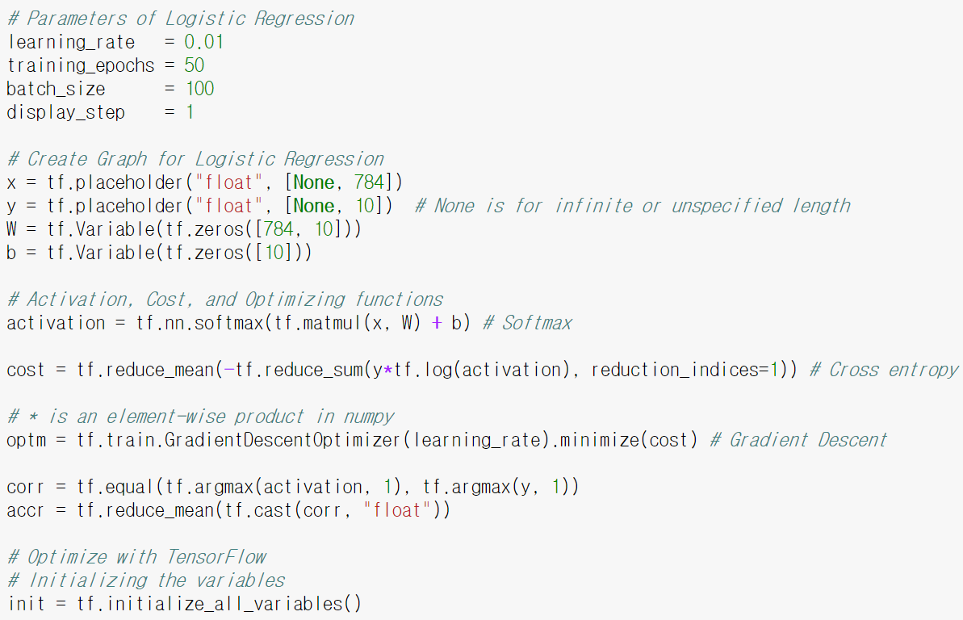
Logistic Regression
91.8% Accuracy on MNIST

Slide 4
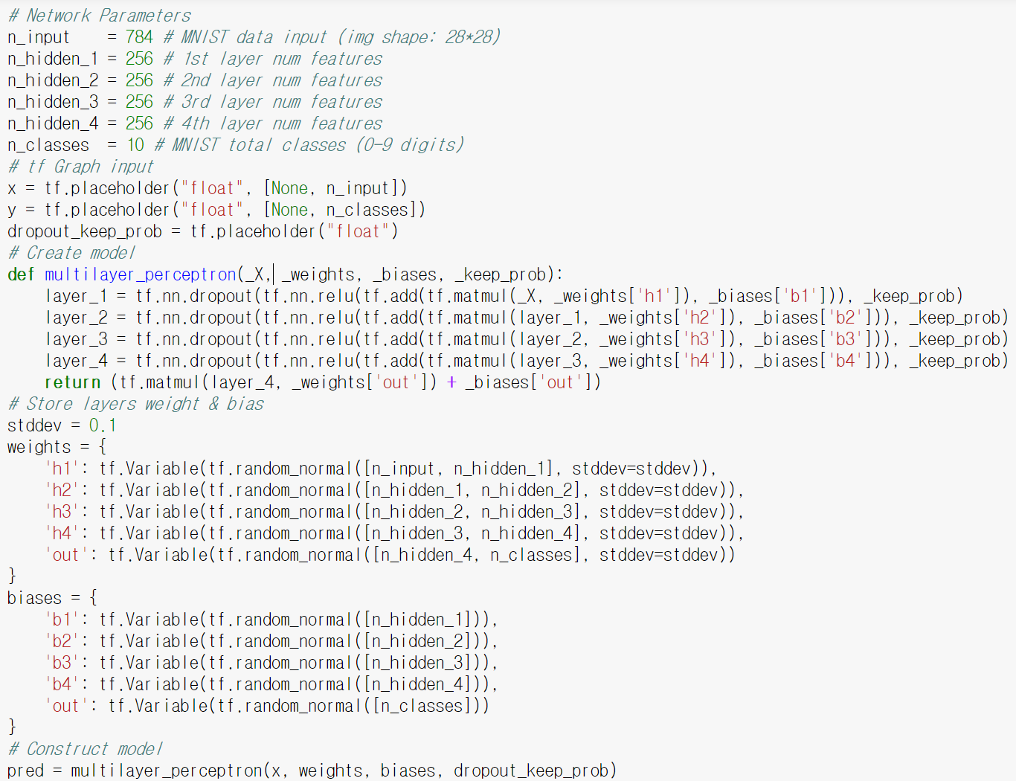
Multi-layer Perceptron
97.1% Accuracy on MNIST

Slide 5
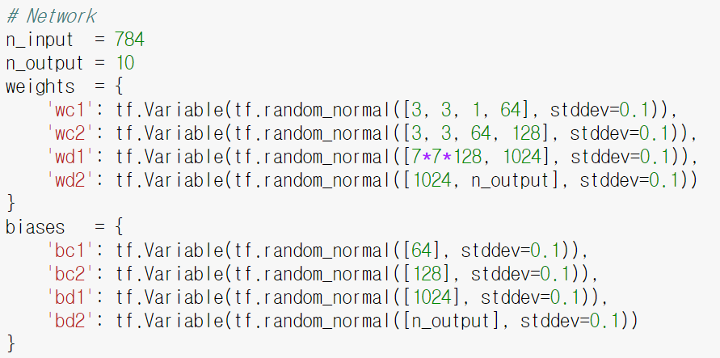
Convolutional Neural Network 1/2

Slide 6
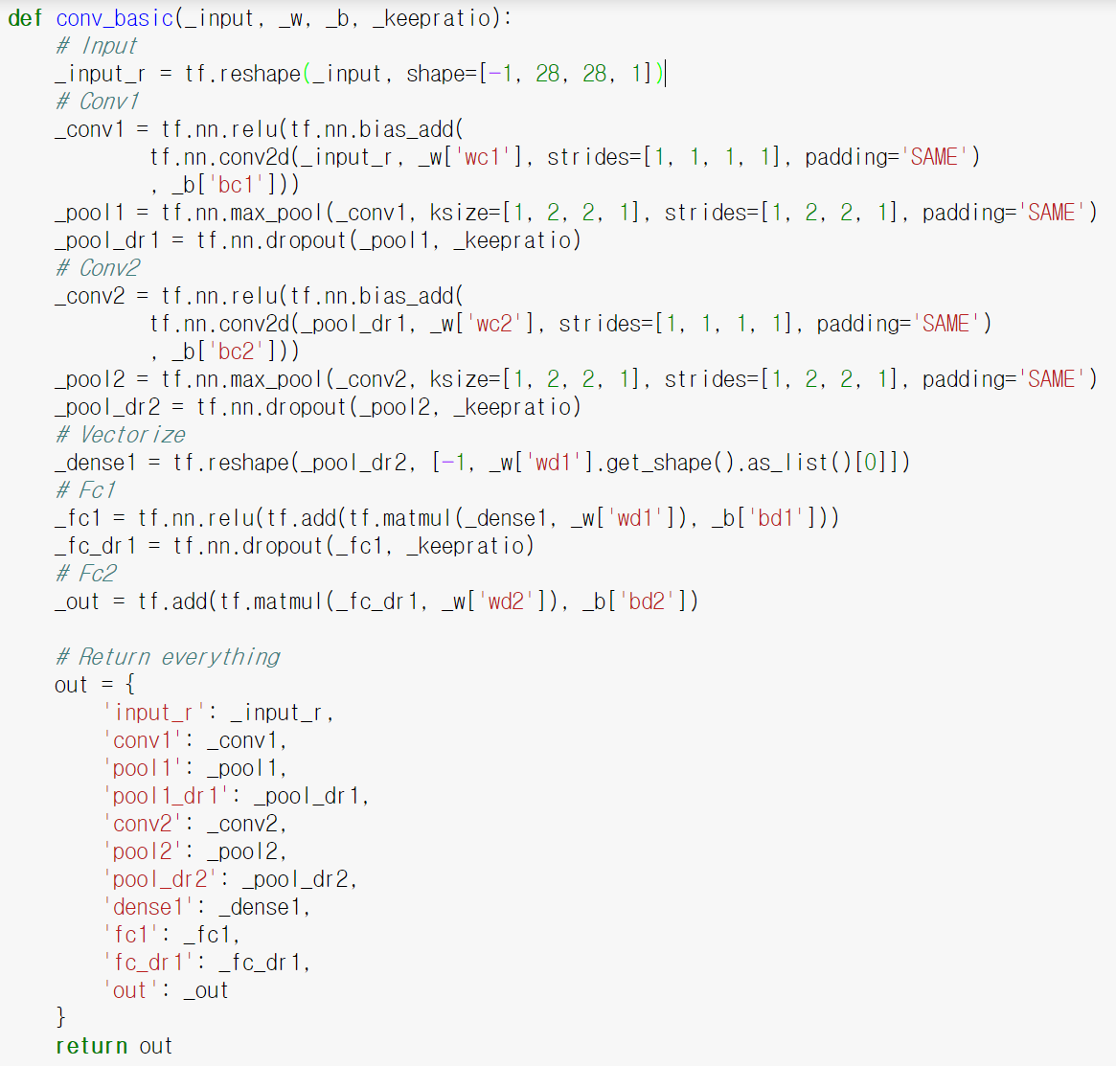
Convolutional Neural Network 2/2
99.2% Accuracy on MNIST

Slide 7
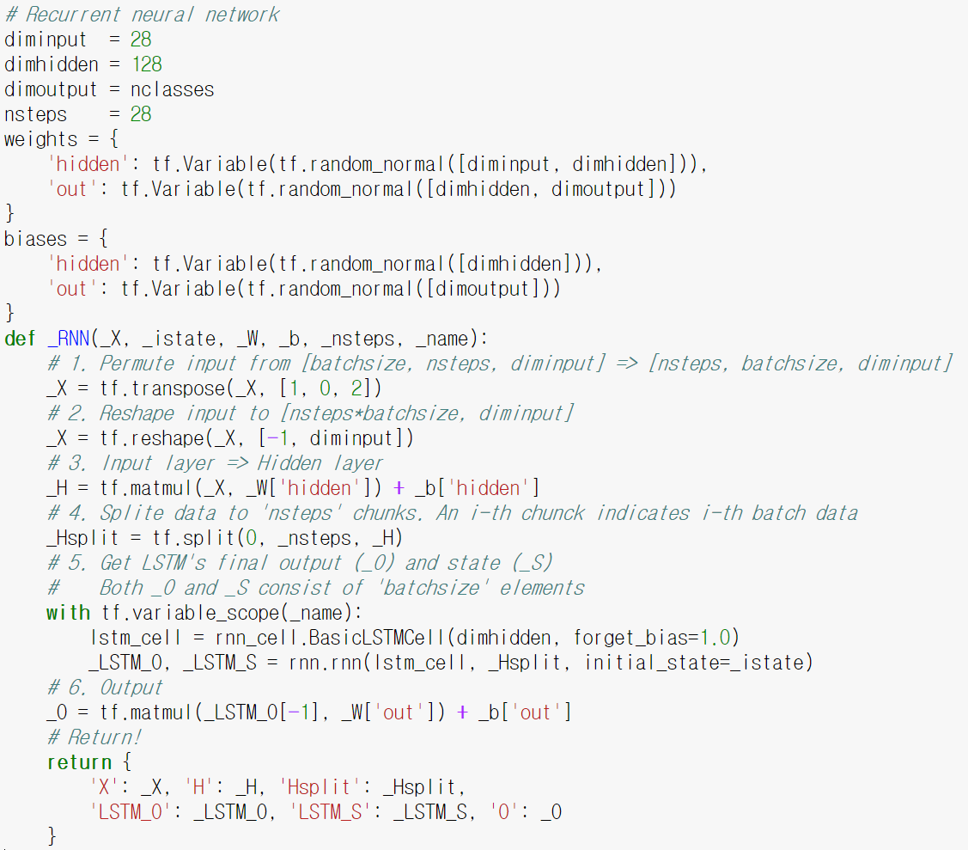
Recurrent Neural Network
96.8% Accuracy on MNIST

Slide 8
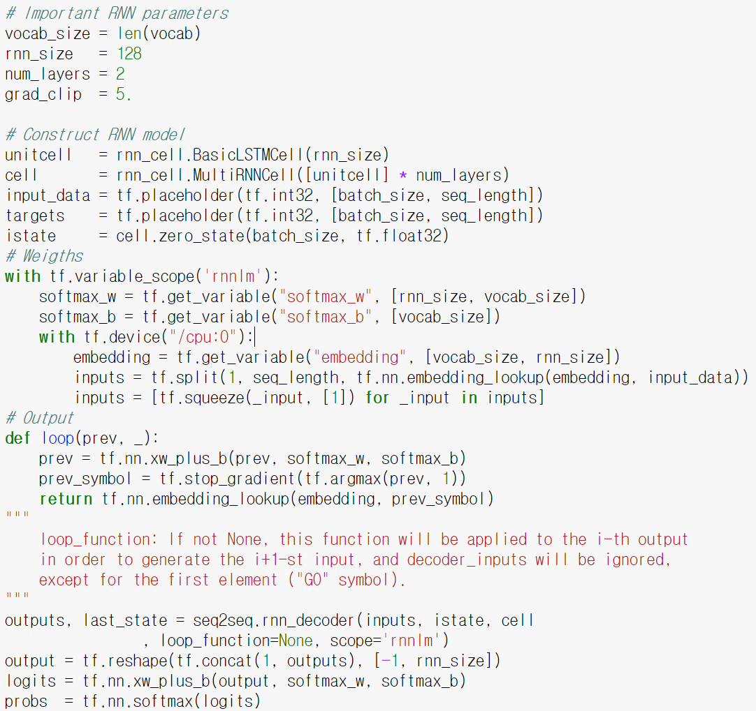
Char-RNN

